Slide 1

AI-Assisted Secure Messaging System
School of Computer Science and Engineering
Department of Computer Science and Engineering
Submitted By:
Keshav Khandelwal
2427030517
Supervised By:
Dr. Rajat Goel

Slide 2
Outline
Introduction
Literature Review
Problem Statement
Proposed Solution
Objectives
Results

Slide 3
Introduction
Secure messaging applications, despite using encryption, still depend on human decisions such as choosing passwords, verifying recipients, managing keys, and responding to security warnings.
The research proposes an AI-assisted secure messaging software that manages cryptographic operations, detects security errors, and provides real-time feedback to users, thereby significantly reducing the probability of security failures.

Slide 4
Literature Review
Human Errors in Secure Communication System:
Cognitive Errors occur when users do not understand cryptographic concepts such as key strength, encryption modes.
Operational Errors include sending messages without encryption, reusing old keys, or ignoring system warnings.
Behavioral Errors include sending sensitive data to wrong recipient, accessing systems from insecure networks.

Slide 5
Emergence of AI in Cybersecurity includes:
Behavior learning
Anomaly detection
Predictive alerts
Automated decision-making
Usable security

Slide 6
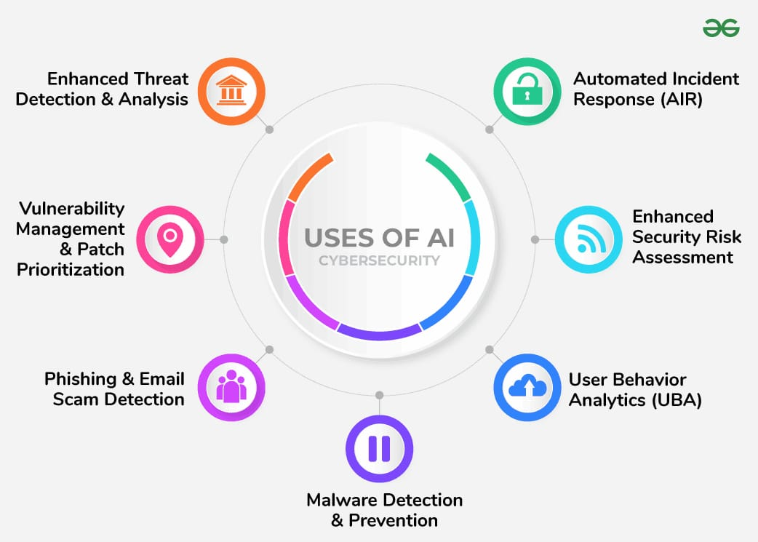

Slide 7
Problem Statement
There is a need for an intelligence system that can proactively detect, prevent and correct security errors in secure communication.

Slide 8
Proposed Methodology
The proposed solution is a AI-assisted secure messaging system that integrates cryptography with behavioral intelligence.
The system enforces security best practices while continuously monitoring user actions to detect deviations that may indicate errors or threats.

Slide 9
Anomaly List
AI detects the following issues:
Weak or predictable cryptographic keys
Hardcoded keys in source code
Use of insecure algorithms (DES, RC4, MD5, SHA-1)
Unsafe cipher modes (AES-ECB)
Unusual access to key vaults
Sudden spikes in decryption failures
Suspicious TLS handshake behaviour
Unauthorized system access attempts
Abnormal file encryption patterns

Slide 10
Warning Detection & Response Mechanism
Warning
AI Detection
System Response
Suspicious Pattern

Slide 11
Objectives
To design an AI-assisted secure messaging framework.
To improve usability and reliability of secure communication.
To analyze human and implementation errors.
To develop an intelligent warning and prevention mechanism.

Slide 12
Result
The result aim to demonstrate reduced human-caused security errors, improved usability of cryptographic communication, and enhanced proactive cybersecurity through AI-driven anomaly detection.

Slide 13
Outcome
The project will deliver an AI-assisted secure messaging prototype capable of early detection of suspicious patterns and security errors, generating real-time security warnings.

Slide 14
References
A. Kahate, Cryptography and Network Security, McGraw Hill, 2011.
W. Stallings, Cryptography and Network Security, 6th Ed., Pearson.
Schneier, Applied Cryptography, Wiley.
Anderson, Security Engineering, Wiley.
Forouzan, Cryptography and Network Security, McGraw-Hill.
Stallings, Network Security Essentials, Pearson.

Slide 15
Thank You

